Slide 1
TUGA IT 2017
LISBON, PORTUGAL

Slide 2





THANK YOU TO OUR SPONSORS

Slide 3

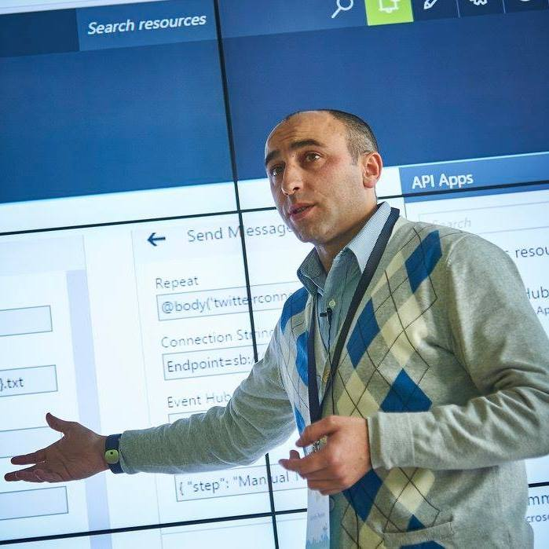


Who am I?
Codeless Wizard
Microsoft Azure & Visio MVP
sandro.pereira@devscope.net
linkedin.com/in/sandropereira
@sandro_asp
https://blog.sandro-pereira.com/
Public speaker
Book author: “BizTalk Mapping Patterns and Best Practices”
Sandro Pereira
Notes:
Interested in all things integration – which of course includes MS Flow

Slide 4
How can PowerApps and Microsoft Flow allows your power users to quickly build Enterprise Mobile Apps
Sandro Pereira
Microsoft Azure MVP

Slide 5
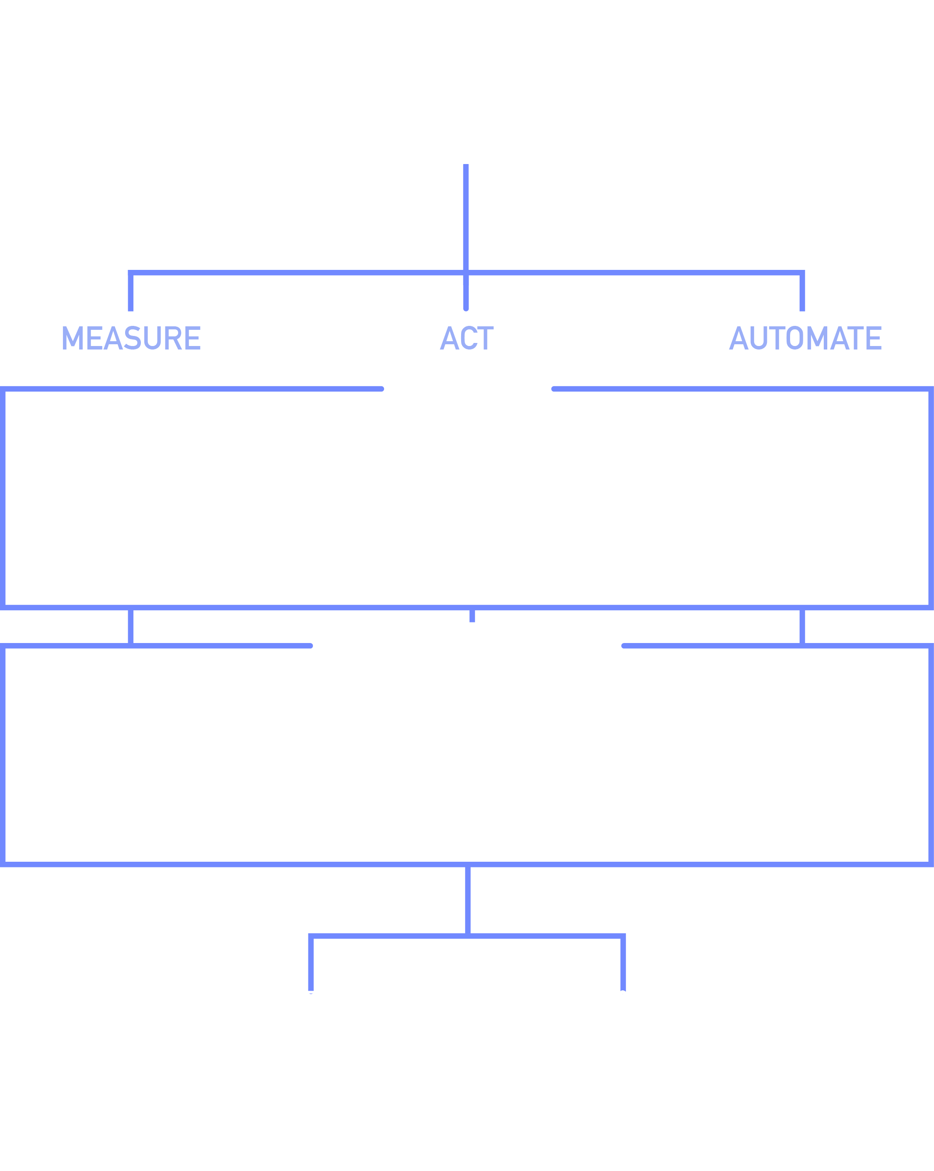
Business Application Platform Innovation
Power users who understand their business challenges the best can now quickly build and deliver solutions without writing code.
Innovate faster
Power users build “no code” solutions
Enterprise Developers and IT pros can now easily extend capabilities for power users.
Take advantage of Rich platform services with power of Azure
Connects to everywhere, securely
It works on all devices, Easy to deploy and test
https://powerusers.microsoft.com/ https://businessplatform.microsoft.com/en-us/
Notes:
Create mobile business apps with clicks, ‘not code’
App Services, Service Fabric, Azure Functions, Logic Apps, API Management, BizTalk…Turn your data into apps

Slide 6
Businesses need to deliver apps in a way that stays extensible, connected, secure and fast
ACT
PowerApps
AUTOMATE
Flow
Connectors to Data and APIs

Slide 7

PowerApps in action
https://web.powerapps.com/apps/7d801708-c8af-4297-884f-50c6031b7ef1

Slide 8
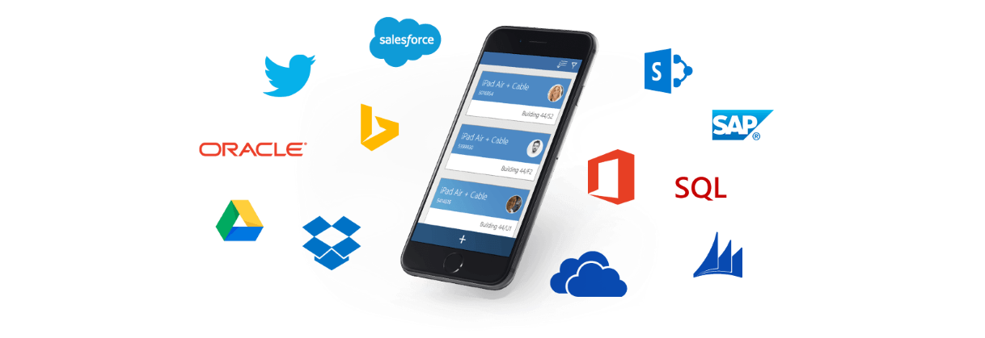
Introduction to PowerApps Custom apps for business needs No-code apps for tablet and mobile

Slide 9

Our consumer apps have rapidly evolved…
Notes:
We’ve come to expect innovation from all the apps we run on our personal devices. Thousands, and thousands of apps.

Slide 10
What’s holding our business apps back?
Notes:
But the business world hasn’t kept pace.

Slide 11
46%
5:1
82%
Data access
Dev capacity
IT agility
Nearly half of enterprise customers will be accessing LOB data from 5 or more sources in 2016 (Forrester)
Demand for mobile apps will outstrip dev capacity by 5:1 in 2016 (Gartner)
82% of IT Dev budgets will be committed to supporting legacy LOB systems in 2017 (IDC)
Notes:
There are many reasons. Data complexity. Talent and training. But fundamentally, the biggest problem is the lack of IT budget dedicated to anything but keeping up with line of business systems.
=====
The Mobility of the Experience -- physically – with 37% of us working from three or more locations.
But also the Mobility of the experience across devices – with about ½ of us using three or more devices for work.
And finally -- our experiences are naturally moving across Apps too -- 82% of information workers use seven or more apps for work.
And as the experience moves – so does the data . . .
“Organizational Blind Spot: The Role of Document-Driven Business Processes in Driving Top-Line Growth,” IDC White Paper sponsored by Ricoh, September 2012
*“Reducing Effort for Banks and Their Customers through Digital Signatures,” CEB TowerGroup, February 2014
**The Cost of Too Much Information: Government Workers Lose Productivity Due to Information Overload, IDC Govt’ Insights, 2012
***

Slide 12
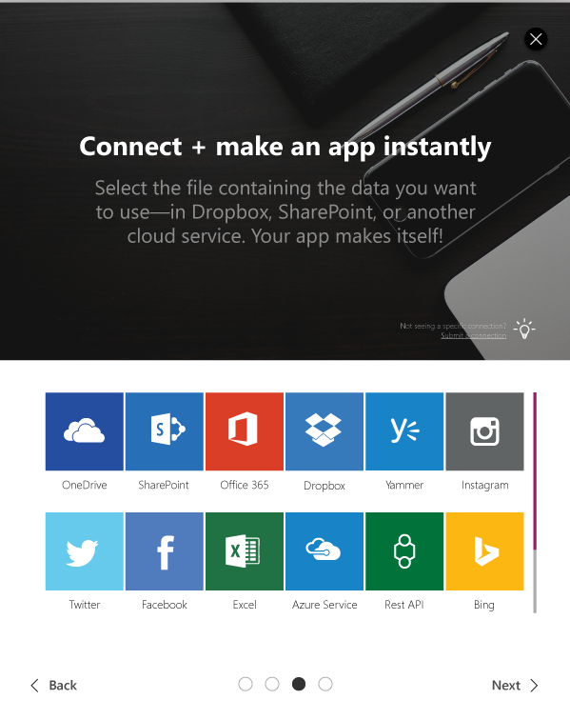
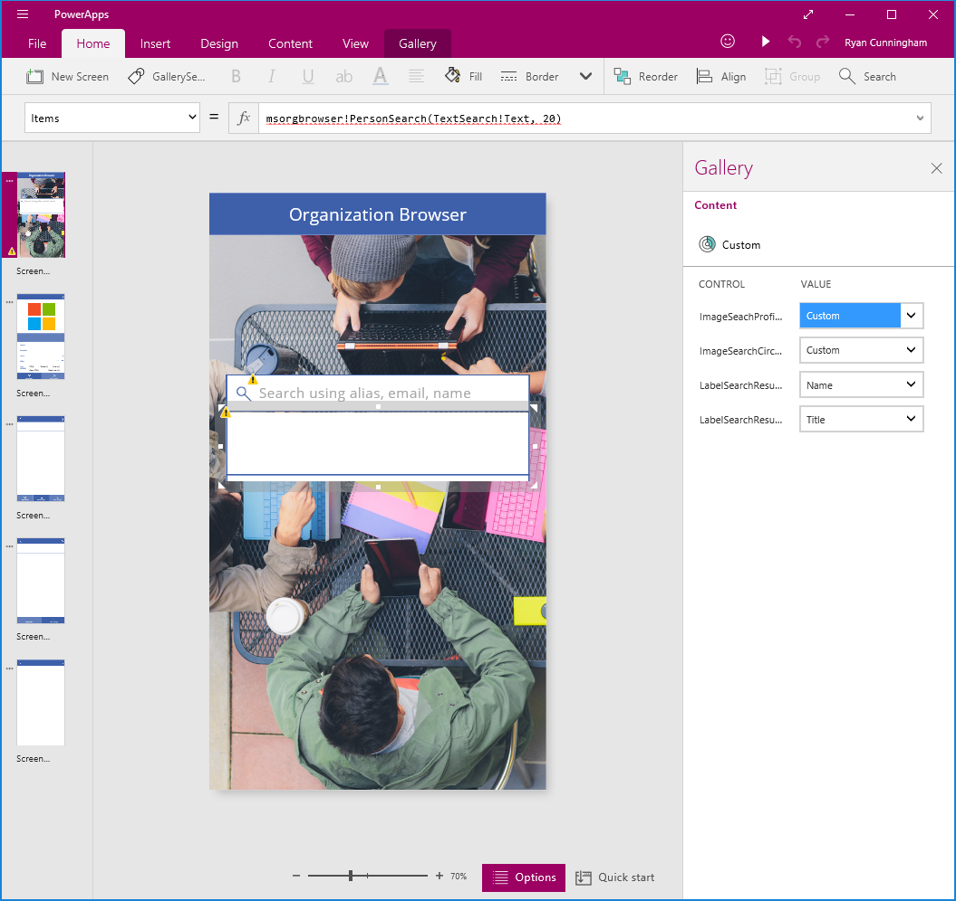
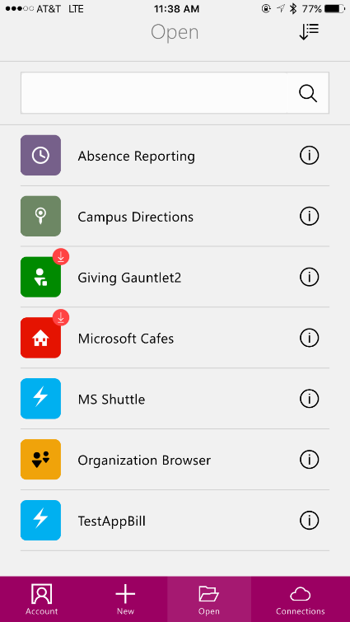
Use PowerApps to rapidly connect and create new apps across your business systems
integrate existing sources or capture new data
create mobile forms and experiences without code
instantly publish to your team on any device
Notes:
Systems that run for decades are critical. But application lifecycles need not be measured in years. Essential business processes sometimes happen in minutes, or days. And we need tools to help us keep up.

Slide 13
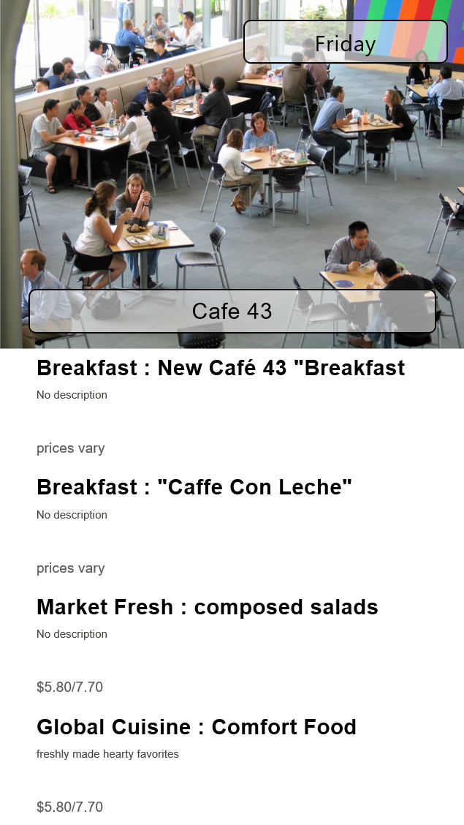
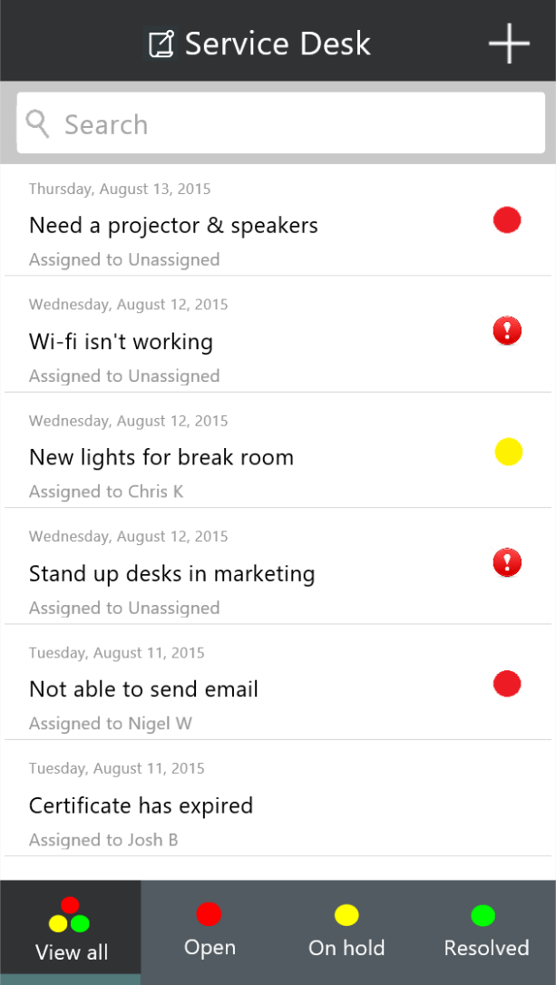
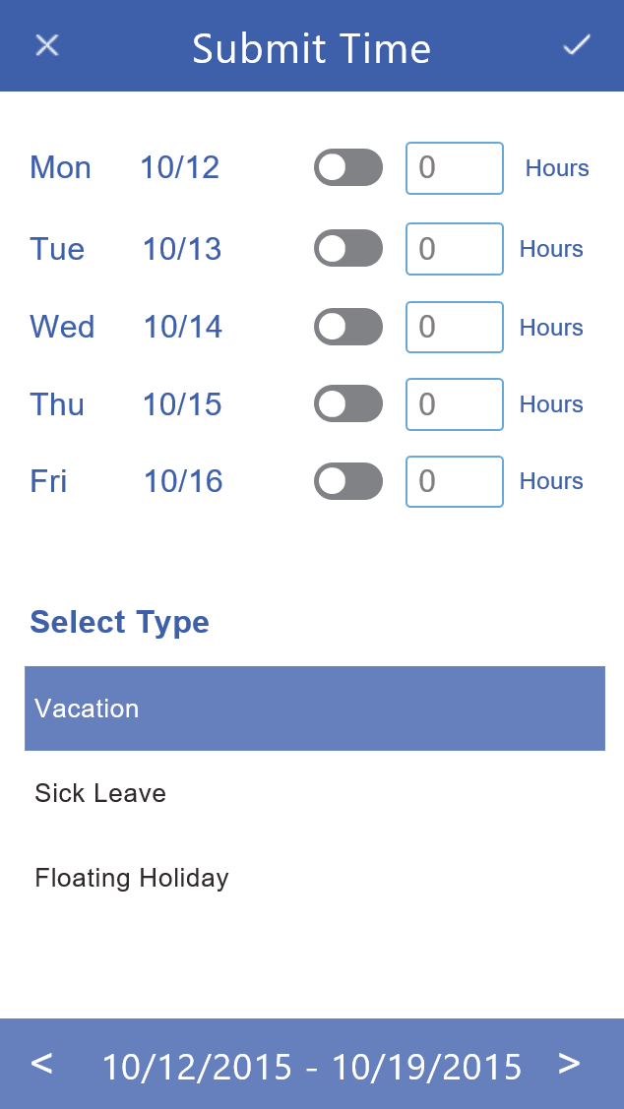
For example…
Engage your employees
Run your business everywhere
Mobilize mission-critical systems
Instant employee surveys
Event-specific signups
Campus resources
Issue tracking across systems
Breaking customer news
Assisted sales experiences
SharePoint apps
Time and expense tracking
ERP and CRM systems
Notes:
We need tools that let us rapidly develop solutions for short term and medium engagement, with minimal impact on the budgets and talent pools dedicated to maintaining classic line of business technology.

Slide 14

SaaS apps
mobile
enterprise services
tablet
business systems
desktop
Connect across your data from the cloud to on-premises
Create new employee apps with easy visual tools
Share securely with your team across devices
Notes:
PowerApps provides a rapid application design canvas for power users and professional developers alike, joining data and mobile devices through the cloud.

Slide 15
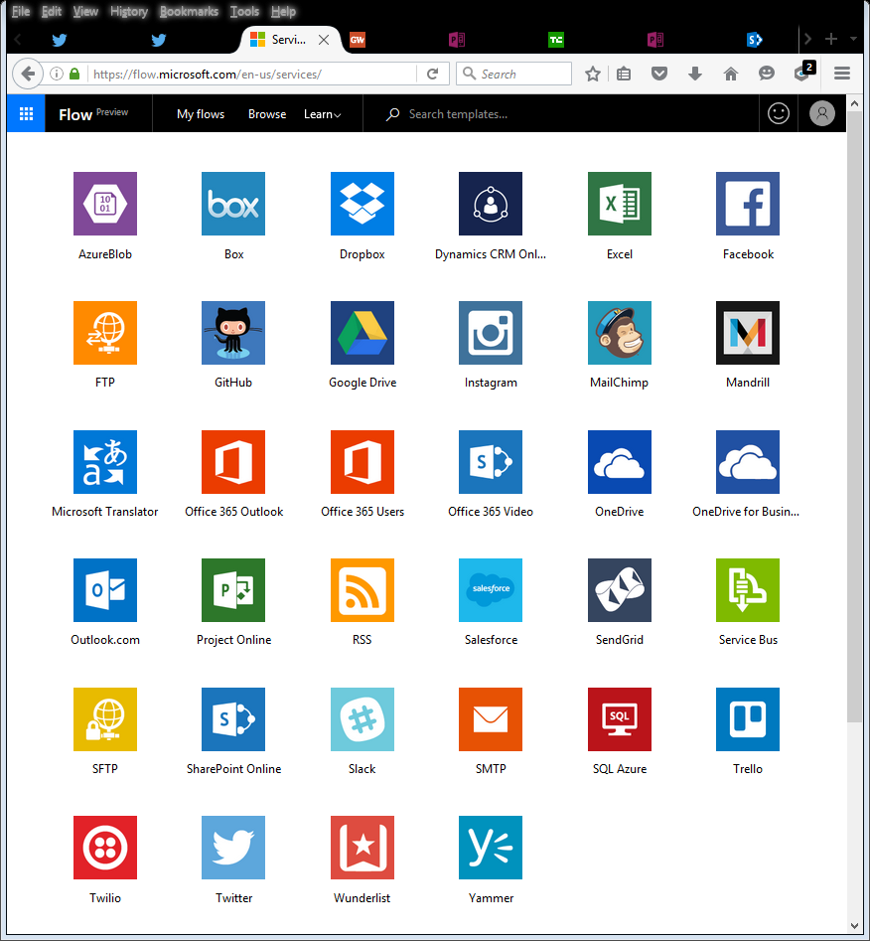
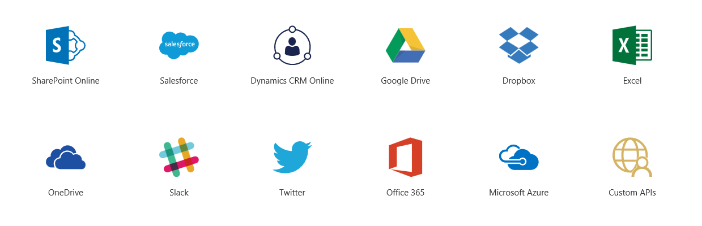
Connect Cloud Services
Connects to the cloud services and data sources you're already using
Gives business analysts and specialists the ability to quickly build apps that suit their specific needs
No code required or struggling with integration issues to connect data
Apps can be published instantly to co-workers across web, tablets and mobile devices without waiting for app stores.
PowerApps also integrates with Microsoft Flow, making it possible to trigger flows from within apps

Slide 16
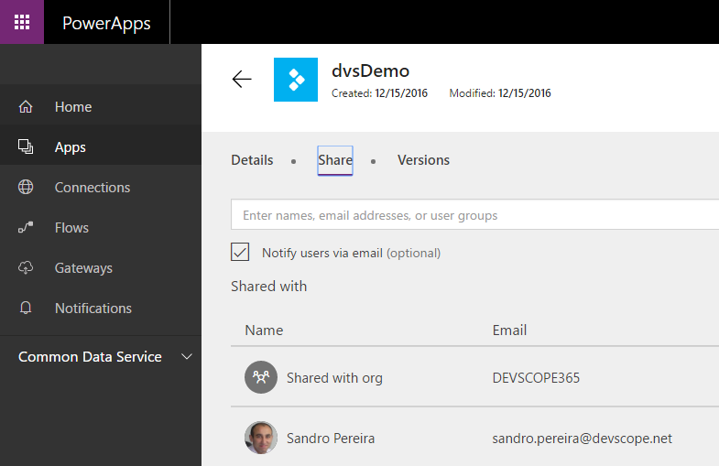
Sharing PowerApps
Azure Active Directory based
Name or email
View or Edit permissions
No personal accounts… today
Separate data connections
Target user leverages their own data connection
Prompted for choice when launching app

Slide 17
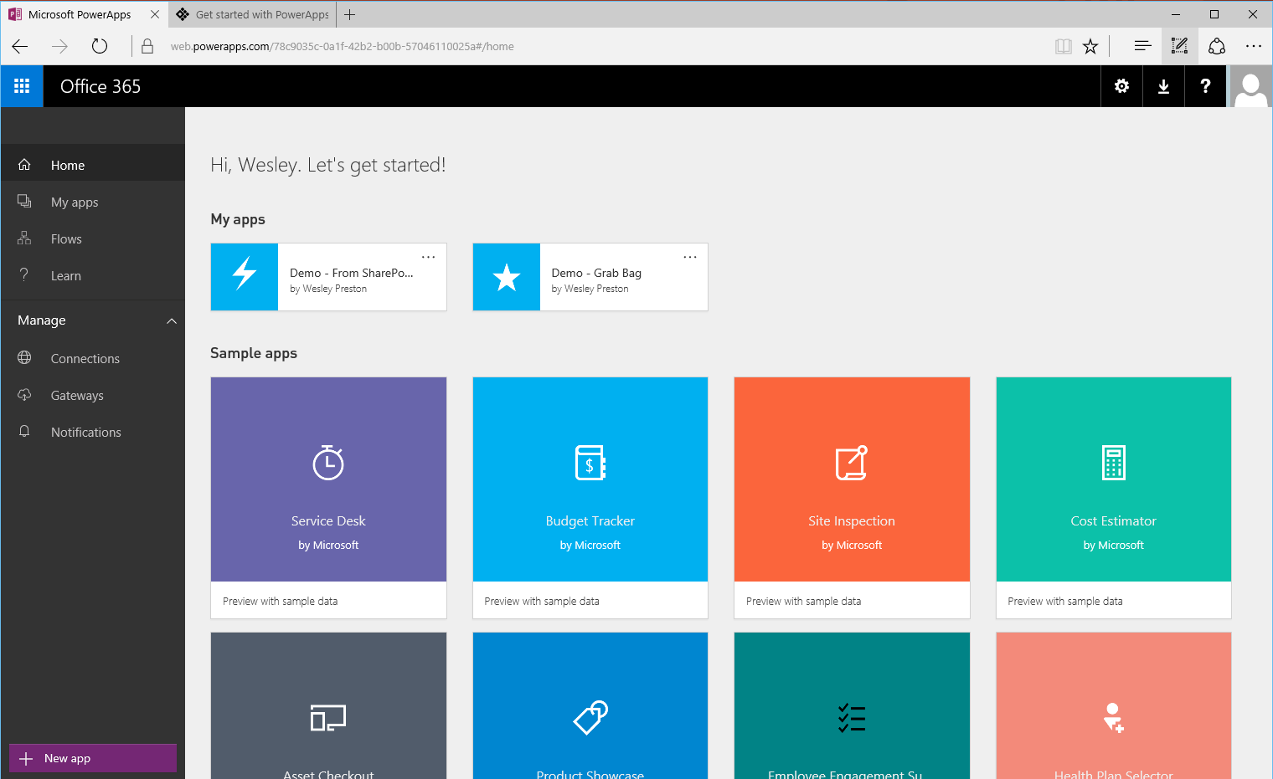
Where you manage PowerApps and how can we get start
PowerApps web portal at https://powerapps.microsoft.com/en-us/
Learn how to use PowerApps (tutorials and videos) at powerapps.microsoft.com/en-us/tutorials
Windows app available through Windows Store
Now is integrated with Office365
Notes:
This is where you start… after you log in.
The site has great documentation to get started… Click on ‘Learn’

Slide 18
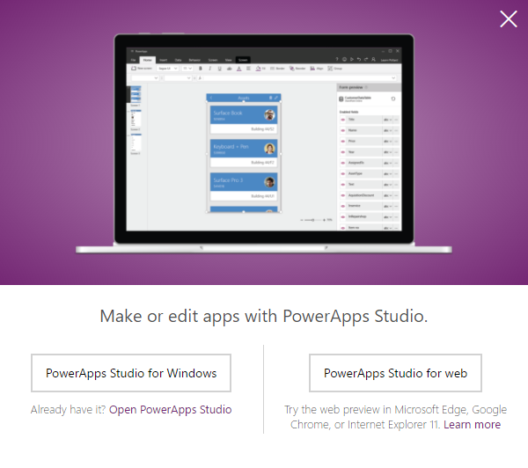
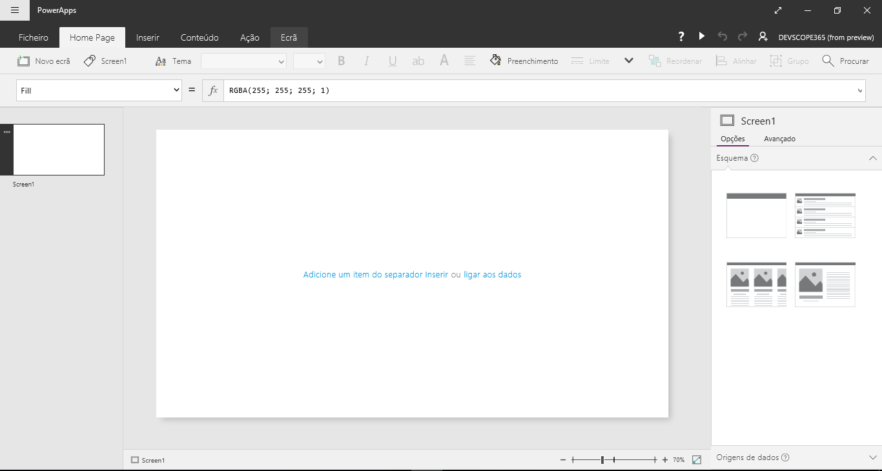
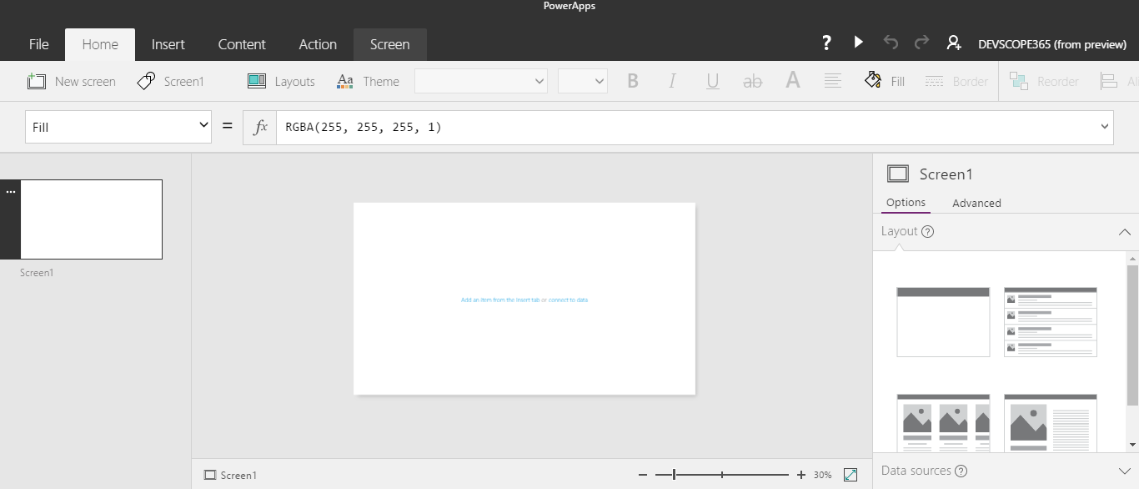
Where you developer (build)…
PowerApps Studio for Web or Windows

Slide 19

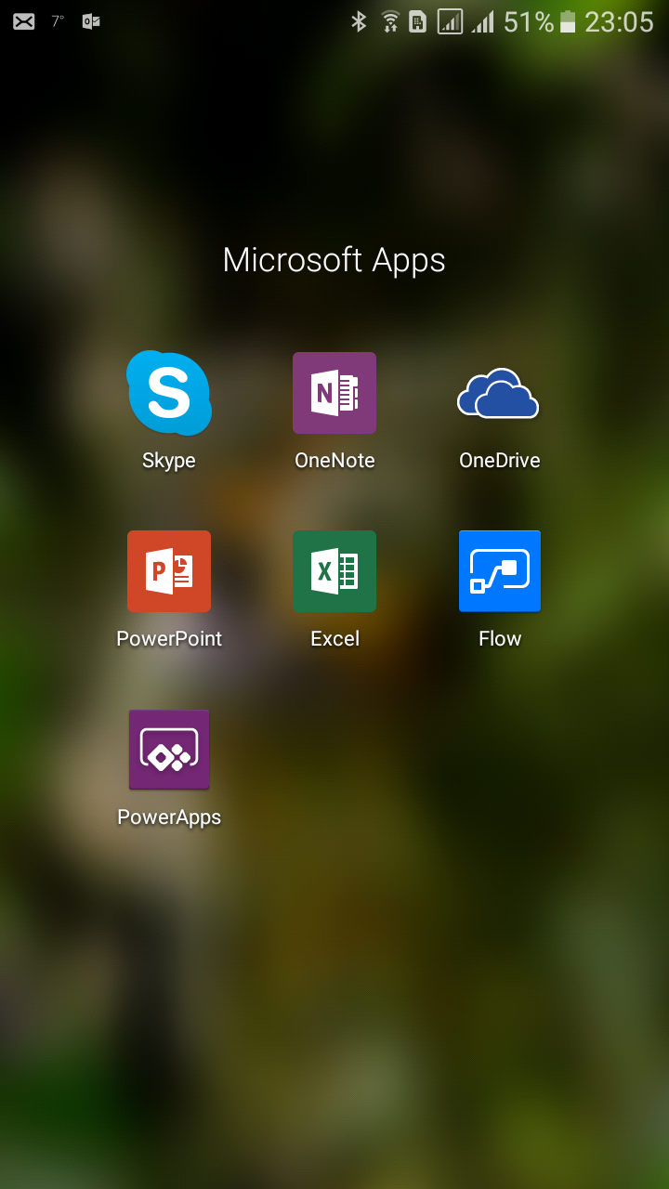


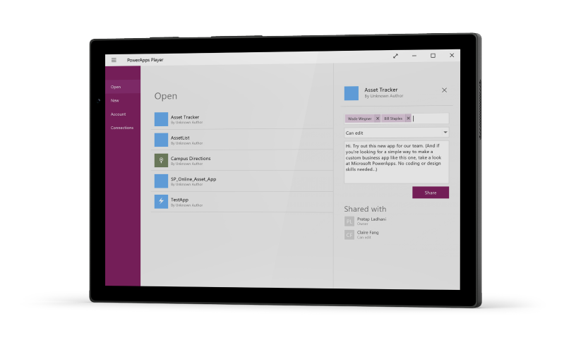
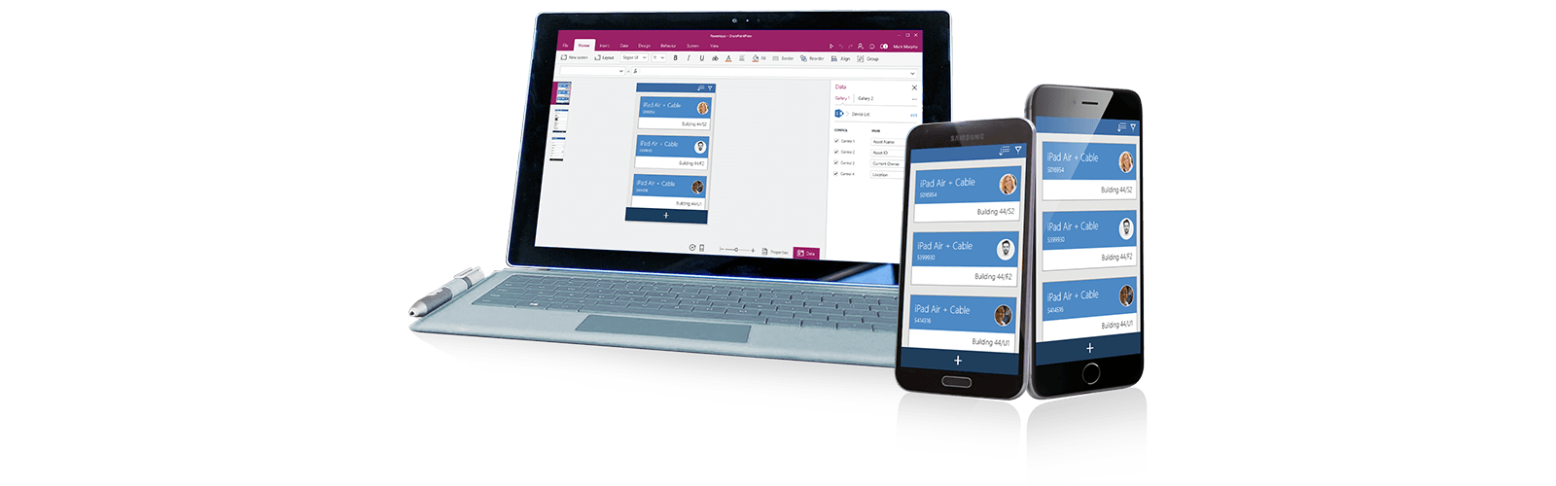
Where you execute them…
Mobile Apps available on iOS, Android and Windows Mobile
Individual PowerApps can be pinned to the home page
Windows app
Web Brower

Slide 20
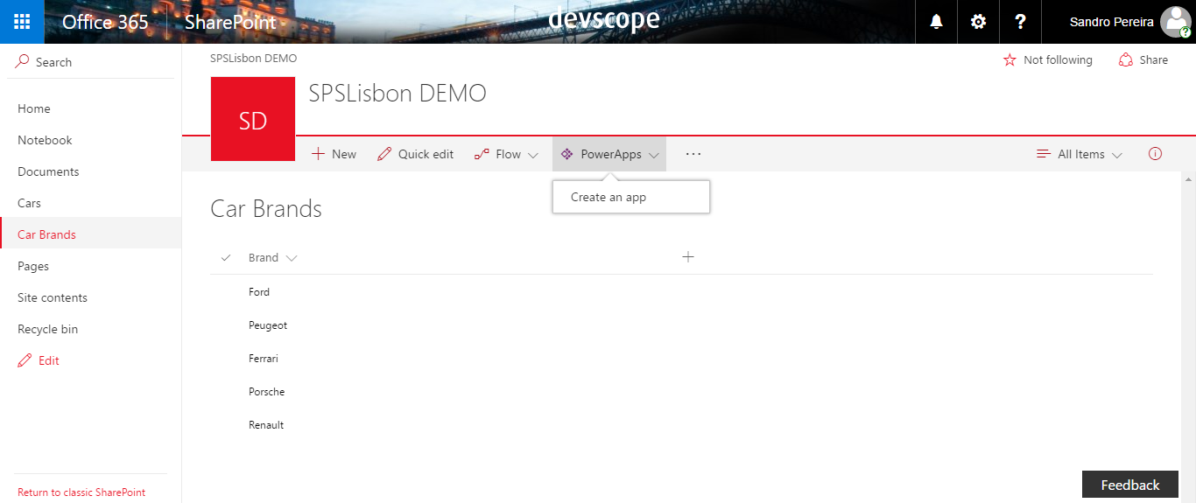
PowerApps and SharePoint
Create new PowerApps from your SharePoint Online list in the browser
Simple CRUD operations (Create, Read, Update, Delete)
Full read/write support for all Sharepoint list data types including Person or Group, Managed Metadata, Lookup, and Multi-select Choice
Support for document libraries
Access on premise using Gateways
https://powerapps.microsoft.com/en-us/blog/powerapps-and-sharepoint
https://powerapps.microsoft.com/en-us/blog/connect-to-your-on-premises-data-sources-using-on-premises-data-gateway-from-powerapps/

Slide 21
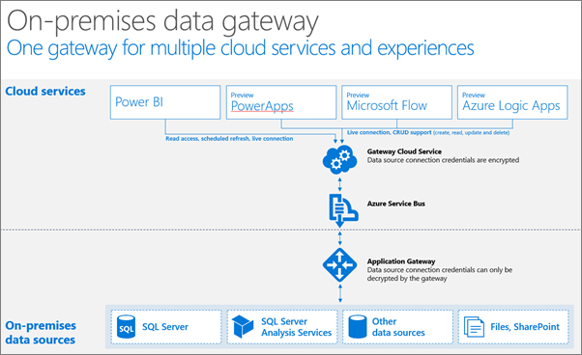
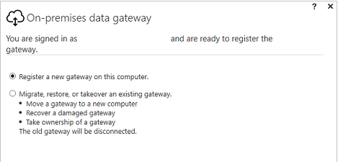
On-Premises Data Gateway
Supports…
SharePoint 2016
SQL Server 2016
Machine should always be accessible
Can’t install on a domain controller
Same technology used by Power BI, PowerApps, and Microsoft Flow

Slide 22

PowerApps – How can I do it?

Slide 23
Introduction to Flow Automated workflows between apps and services Cross-platform data exchange

Slide 24
Most business integration challenges today are met with a single solution
Notes:
Human beings are actually great systems integrators today. We constantly move information around, from our phones, to our PCs, to our “data systems” that that range from a new SaaS tool, to pen and paper. We receive an input or notification on one of our devices, and we cascade it into another routine action.
Some real life examples:
Our teams are constantly meeting people at events and following up over email. We want to ensure we don't miss any of these leads, but re-typing information from emails into our CRM system is tedious.
We work with agencies who create content and upload large files to OneDrive or Dropbox accounts. Our teams want to know right when the latest files arrive, without having to check every 30 minutes, and then they want to transfer a backup to a save cloud storage as soon as it comes through to ensure we don’t loose any valuable work.
I get hundreds of emails every day, and my notification options are all-or-nothing. It’s hard to keep up with all that traffic when I’m travelling. I’d like to get an SMS when specific people like my boss or a key customer prospect reach out directly to me
However, humans aren’t especially efficient system integrators. What if we could automate these processes?
Most of these system are seen as "not designed to work with each other" and integration projects between these systems will quickly become complex IT projects that take a long time to execute and require deep integration expertise.
What if we could automate routine tasks to be more efficient as a business users?
What if we could enable new uses and accomplish things we can’t currently do today by relying on powerful process automation that does not require length IT projects?

Slide 25
People
Notes:
Human beings are actually great systems integrators today. We constantly move information around, from our phones, to our PCs, to our “data systems” that that range from a new SaaS tool, to pen and paper. We receive an input or notification on one of our devices, and we cascade it into another routine action.
Some real life examples:
Our teams are constantly meeting people at events and following up over email. We want to ensure we don't miss any of these leads, but re-typing information from emails into our CRM system is tedious.
We work with agencies who create content and upload large files to OneDrive or Dropbox accounts. Our teams want to know right when the latest files arrive, without having to check every 30 minutes, and then they want to transfer a backup to a save cloud storage as soon as it comes through to ensure we don’t loose any valuable work.
I get hundreds of emails every day, and my notification options are all-or-nothing. It’s hard to keep up with all that traffic when I’m travelling. I’d like to get an SMS when specific people like my boss or a key customer prospect reach out directly to me
However, humans aren’t especially efficient system integrators. What if we could automate these processes?
Most of these system are seen as "not designed to work with each other" and integration projects between these systems will quickly become complex IT projects that take a long time to execute and require deep integration expertise.
What if we could automate routine tasks to be more efficient as a business users?
What if we could enable new uses and accomplish things we can’t currently do today by relying on powerful process automation that does not require length IT projects?

Slide 26

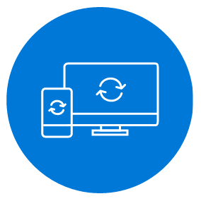


Microsoft Flow helps non-developers work smarter by automating workflows across apps and services
Get notifications
Synchronize files
Collect data
Automate approvals
Notes:
Microsoft Flow is a SaaS service that helps business users work smarter by automating workflow across a growing number apps & services that they rely on.
The possible workflows span across a wide variety of possibilities, for example :
Get a notifications when a certain file is updated
Synchronize files by connecting your folders to keep data current,
Automatically collect and organize your business data
Streamline approvals and get instant alerts.
Microsoft Flow makes it possible to automate all of these scenarios and more.

Slide 27
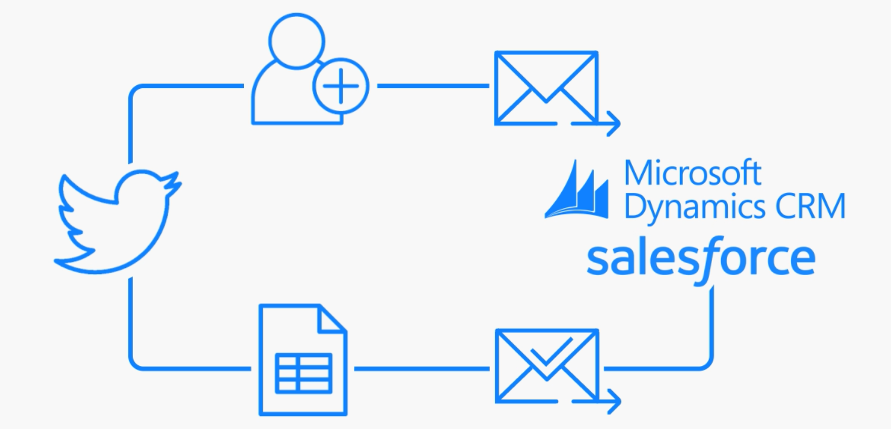


Automate advanced scenarios with multiple steps, branching conditions, and more
Notes:
Create more advanced integration scenarios with multiple steps, adding conditions between steps and the every expanding list of more advanced enterprise connectors.

Slide 28





















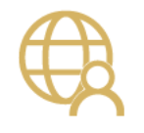




Click-to-code for integrating the systems you’re already using… even custom APIs.
New services being added every week!
https://flow.microsoft.com/manage/connections/available
Notes:
Get a whole bunch of connectors OOTB to common SaaS Services, from O365 (Outlook, OneDrive) to collaborative svcs (Slack) to CRM svcs (Salesforce, Dynamics CRM)
Can support connections to custom APIs (Swagger end point definition)
URL for full list of connectors

Slide 29
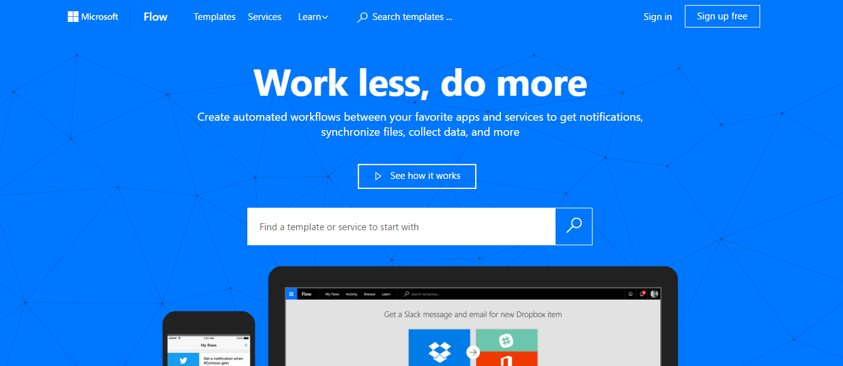
Where you manage Flow and how can we get start
Flow web portal at https://flow.microsoft.com/en-us/
Learn how to use Flow (tutorials and videos) at https://flow.microsoft.com/en-us/guided-learning/
Now is integrated with Office365
Notes:
Microsoft Flow makes it possible to automate all of these scenarios and more.
No code, no workflow – configure the connectors
Go to landing page and choose or search for a template
Sign in
Configure the connectors in the template

Slide 30
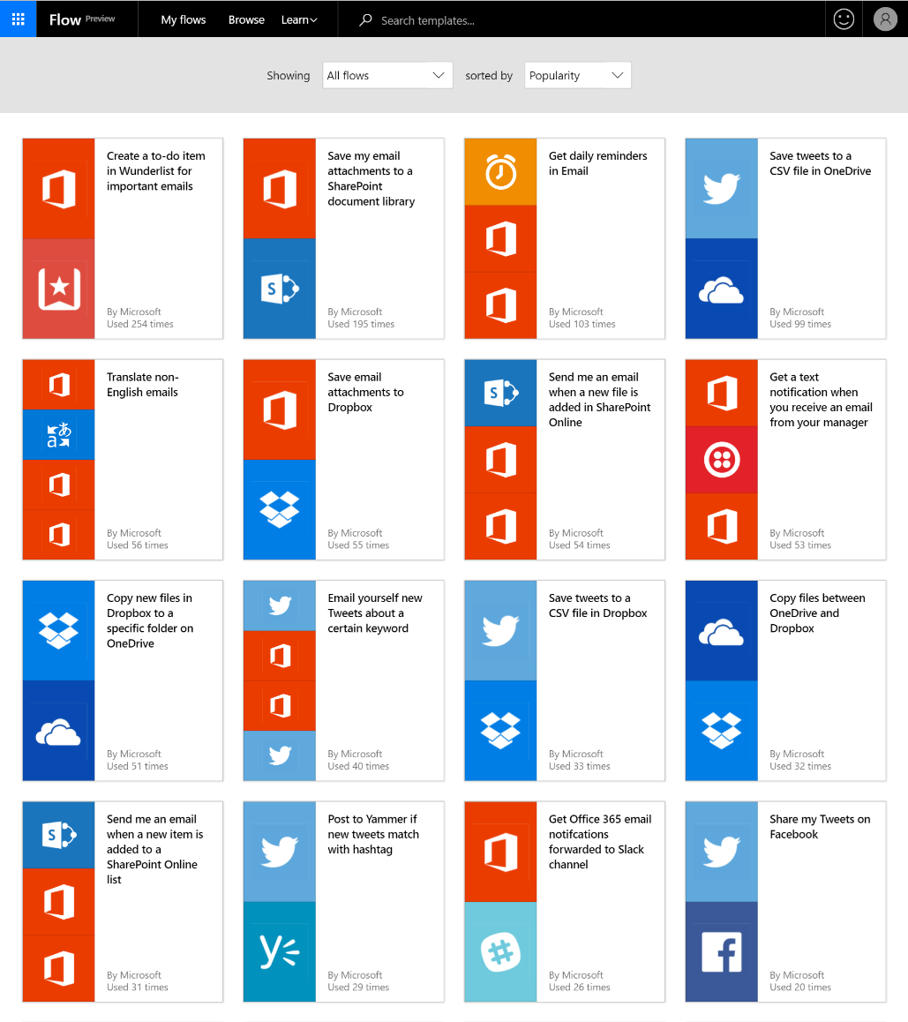
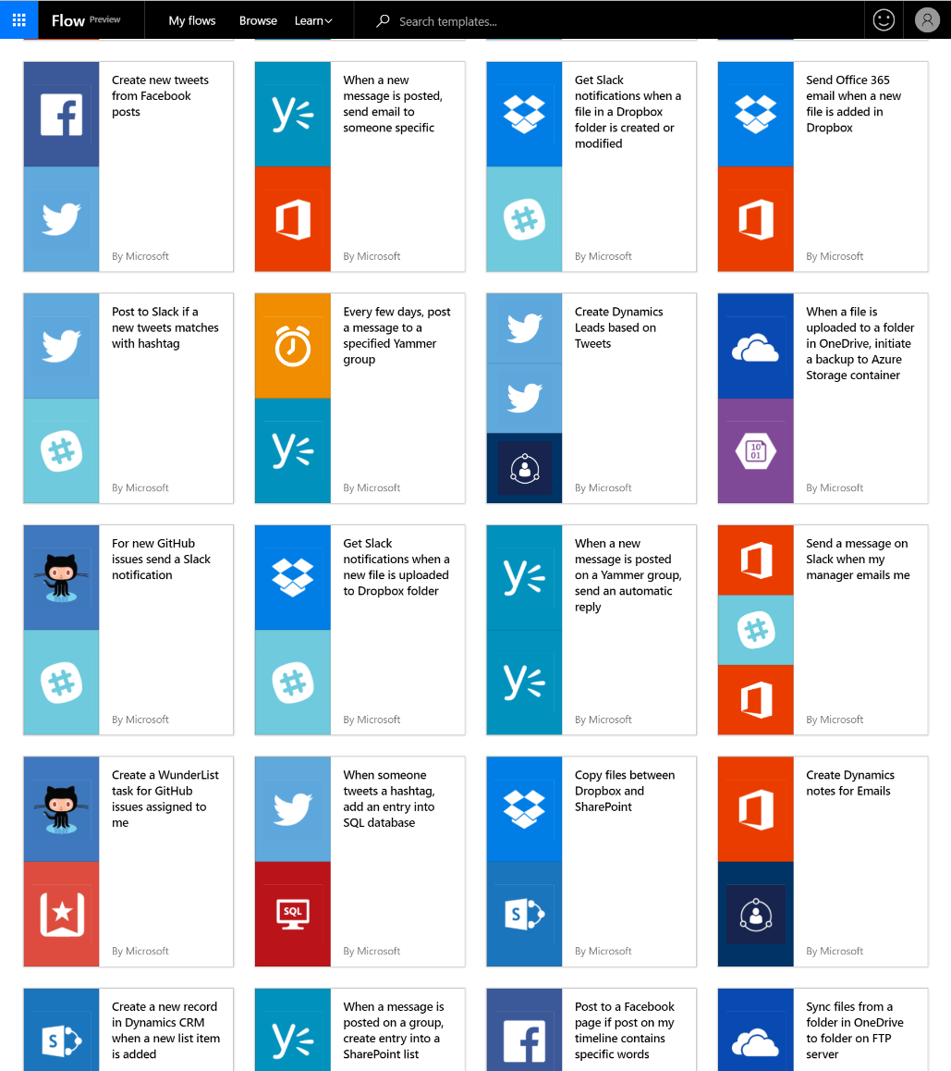
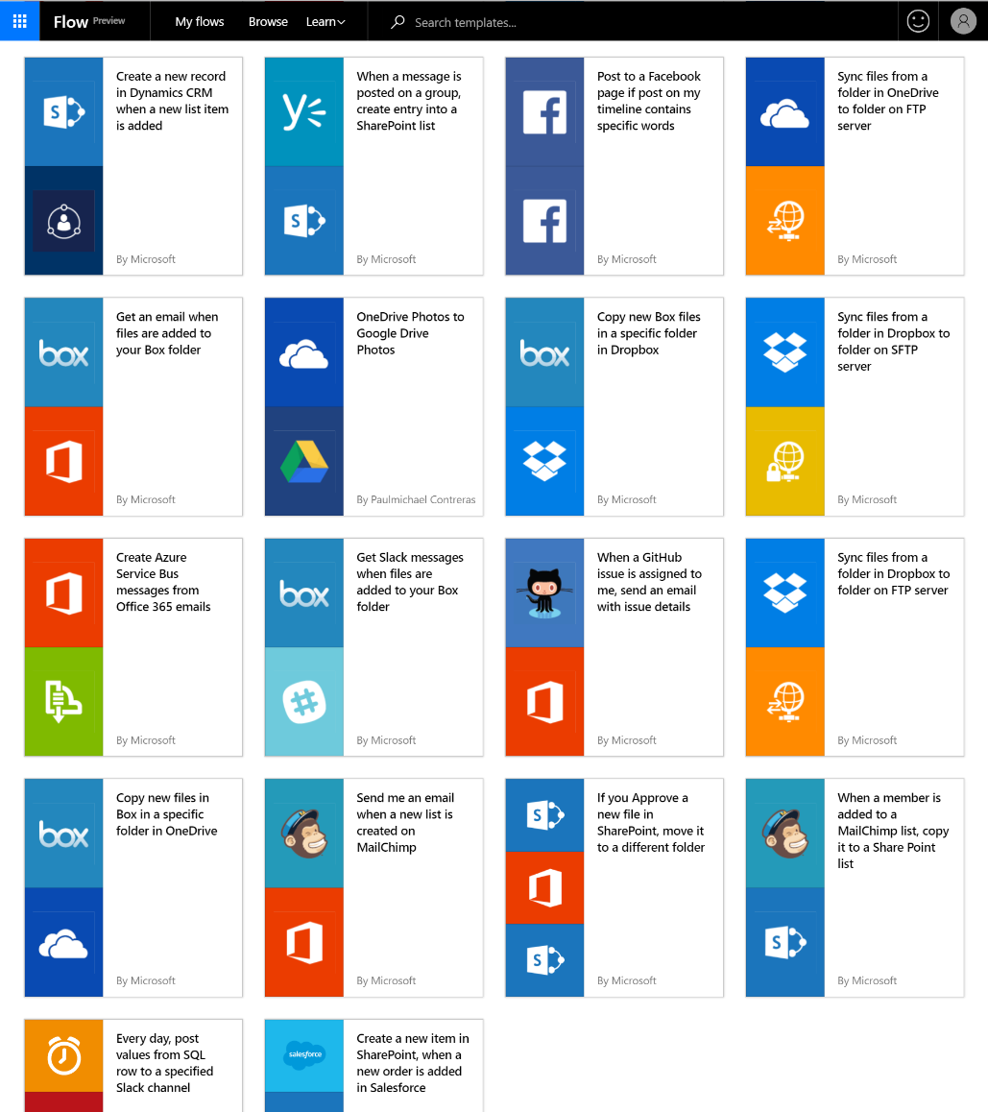
Get started quickly with hundreds useful templates
Notes:
User over 100+ templates (and growing) for common scenarios as a starting point to create your new workflow!

Slide 31
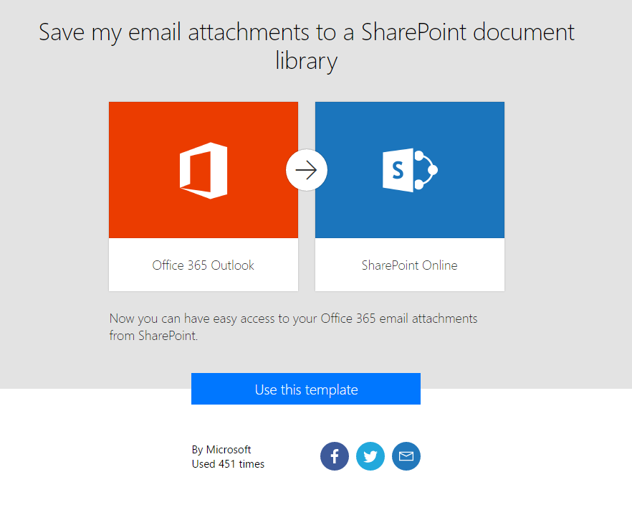
Simple explanation + landing page for templates
Detailed description of what the template does and needs
See how much this template has been used and who published it
Easily share templates via social media or email with your colleagues or friends
Notes:
Microsoft Flow is a SaaS service that helps business users work smarter by automating workflow across a growing number apps & services that they rely on.
The possible workflows span across a wide variety of possibilities, for example :
Get a notifications when a certain file is updated
Synchronize files by connecting your folders to keep data current,
Automatically collect and organize your business data
Streamline approvals and get instant alerts.
Microsoft Flow makes it possible to automate all of these scenarios and more.

Slide 32
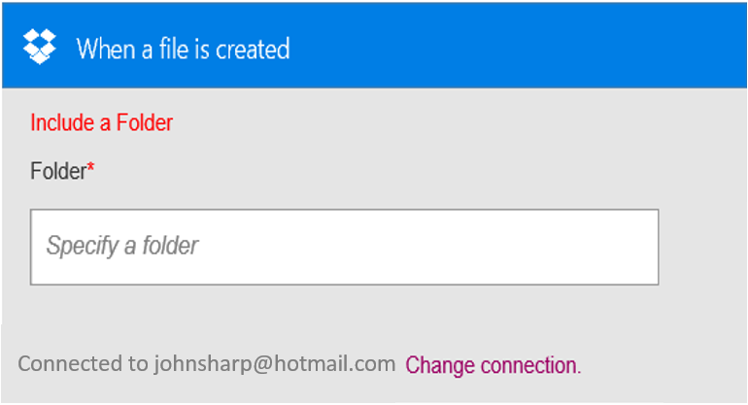
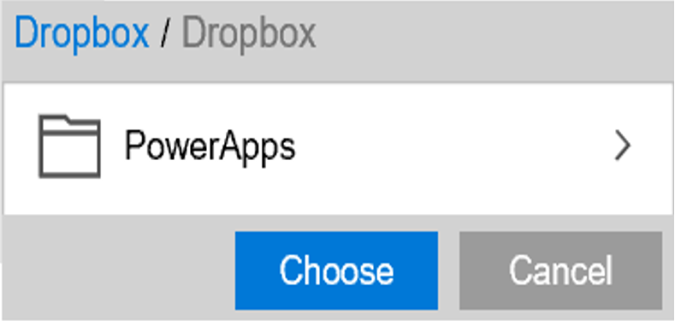
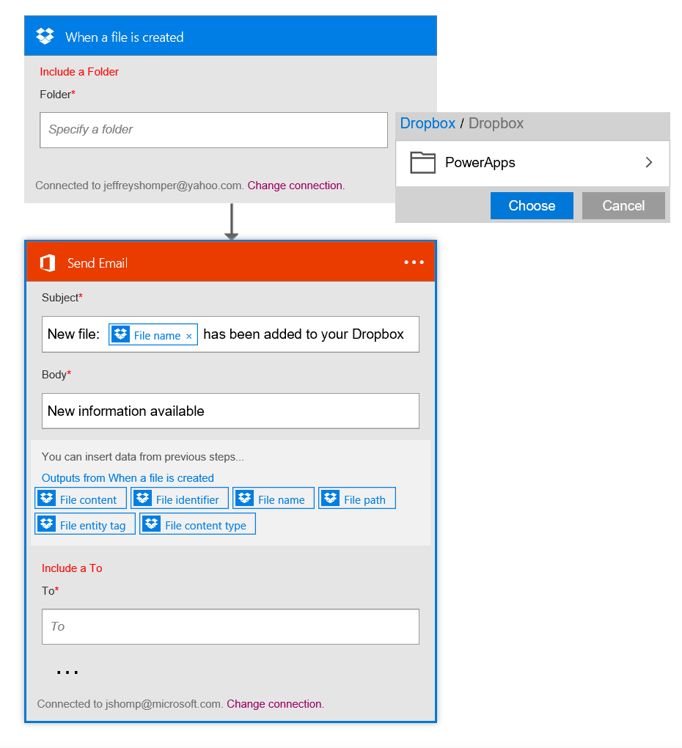
Build your own flow from scratch
Sending an Exchange email when a new file is added in Dropbox
Authenticate to your Dropbox account.
Select folder to monitor
PowerApps
Choose to include properties from previous step (Dropbox file) to improve relevance
Authenticate to your O365 account. Build email Subject and Body
Specify Send To email address and additional properties (optional): From, CC, BCC and Importance
Connected to johnsharp@contoso.com
Notes:
In addition to utilizing Templates, end-users can easily build their own Flows or customize any of the available templates through an easy to use visual designer.

Slide 33
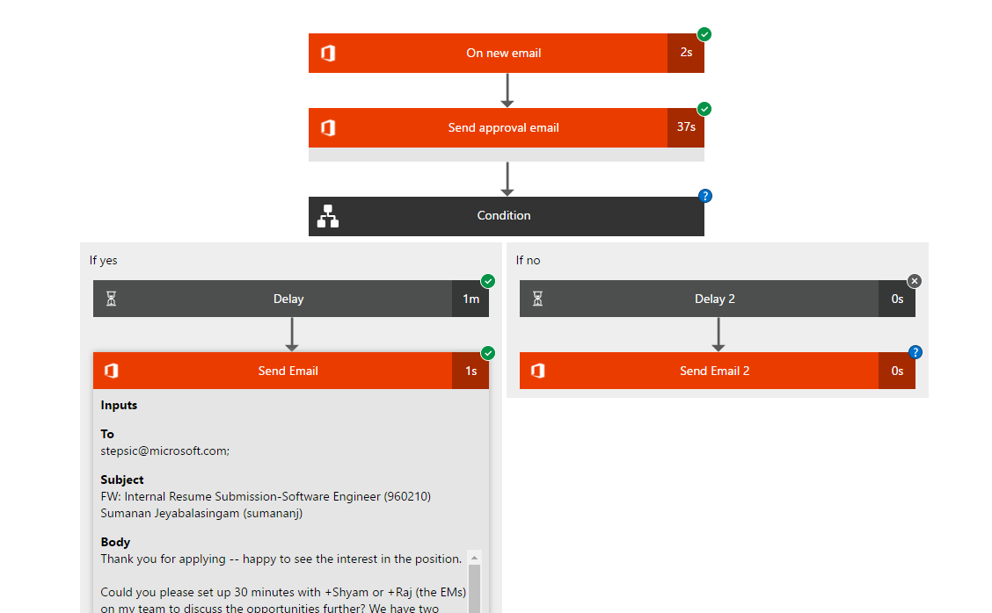
Debug any flow if needed
Save visual representation as building / creation time
See detailed inputs / outputs for each step

Slide 34
Consolidated list of all connectors
Same list of connections is shared between PowerApps and Flow so you only have to sign in once
If your password changes or you revoke the application access you can come here to sign-in again and fix it
Delete connections if you no longer want Flow and PowerApps to be able to access that data

Slide 35
Why are we talking about Flow?
Integration is a problem that spans the enterprise
Limited resources / time for central Integration specialists; unmet need for office workers
Flow enables “self-service” for simple integrations
Notes:
Can’t think of a single organisation that does NOT have a need for integration
Integration is a specialised skill
Some integration needs are very simple and/or very common

Slide 36
…not to mention
Another tool in our integration strategy (in addition to BizTalk, Logic Apps, API-Mgmt, etc.)
Assets are transferable: same APIs / connectors from Logic Apps + BizTalk can be used in Flow
Bigger role for Integration inside of companies / organizations
Notes:
Can’t think of a single organisation that does NOT have a need for integration
Integration is a specialised skill
Some integration needs are very simple and/or very common

Slide 37
But…. Who is the audience for Flow?
Flow focus: Business Users & Specialists
Volume
BizTalk & Logic Apps focus: IT Pro / Developers
Sophistication

Slide 38


Under the hood of Flow
Flow is good for simple integrations and empowering users to do integrations without going through devs + IT
However, sometimes IT / devs need to take over when the Flow gets too advanced or becomes business-critical
Any Flow can be converted to a Logic App (will be one-click later this year)
Notes:
Can’t think of a single organisation that does NOT have a need for integration
Integration is a specialised skill
Some integration needs are very simple and/or very common

Slide 39
Example Use Cases
Enriching or pushing data to existing store; e.g.
take customer information from SalesForce / CRM and add it to a SharePoint list
Approval workflows for common administrative tasks; e.g.
resume screening; vacation requests; etc.
Capturing data for better visualizations
take data from an “unsupported” database and push it into Power BI (using Excel or SQL connectors)
Notes:
Can’t think of a single organisation that does NOT have a need for integration
Integration is a specialised skill
Some integration needs are very simple and/or very common

Slide 40
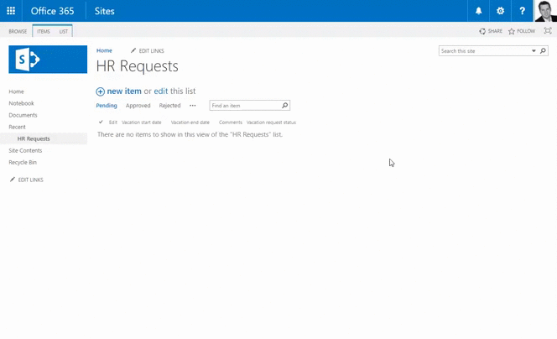
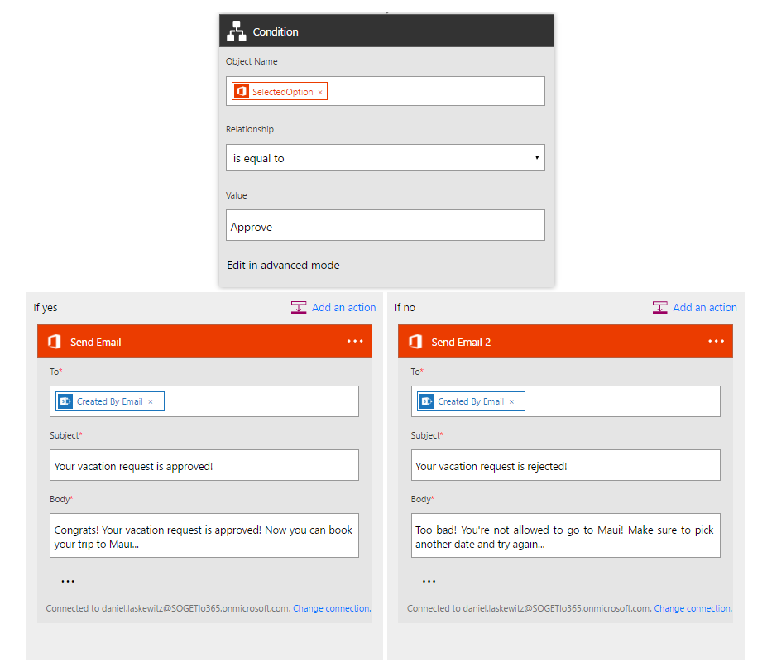
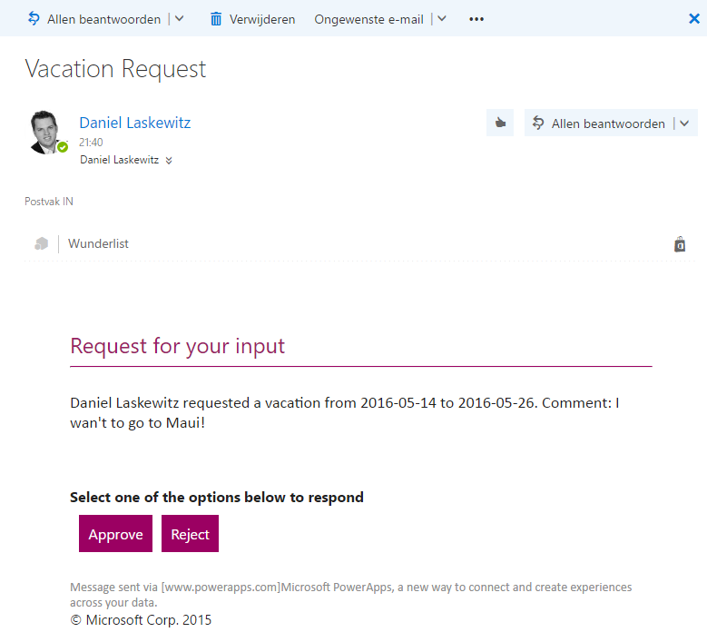
Flow + SharePoint
Notes:
Can’t think of a single organisation that does NOT have a need for integration
Integration is a specialised skill
Some integration needs are very simple and/or very common

Slide 41
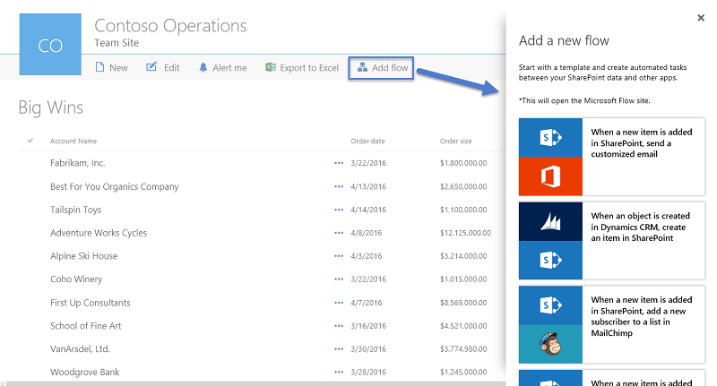
Flow available for Office workers
Embedding where it makes sense
Focusing on information products (not dev tools)
SharePoint Online is now available
Notes:
Can’t think of a single organisation that does NOT have a need for integration
Integration is a specialised skill
Some integration needs are very simple and/or very common

Slide 42
Flow in action

Slide 43


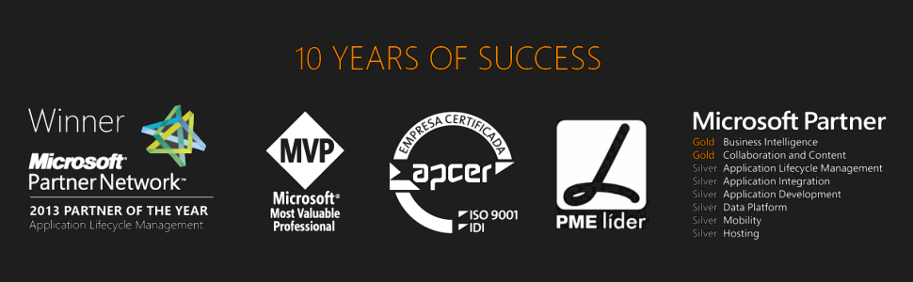



Thanks
sandro.pereira@devscope.net
linkedin.com/in/sandropereira
@sandro_asp
sandroaspbiztalkblog.wordpress.com
+351 223 751 350
www.devscope.net

Slide 44
THANK YOU TO OUR SPONSORS

